Slide 1
Point-of-Sale (POS) Efforts in South Carolina
South Carolina Department of Alcohol and Other Drug Abuse Services
Reston Hartsell, MS-MPH
Synar/Tobacco Prevention Coordinator

Slide 2
Objectives
South Carolina Department of Alcohol and Other Drug Abuse Services
Provide a brief overview of the Counter Tools program
Discuss who is involved with POS efforts
Examine what the field is doing/has done to address POS issues
Discuss the DAODAS vision for POS efforts

Slide 3
What is Counter Tools?
South Carolina Department of Alcohol and Other Drug Abuse Services
Counter Tools, Inc. is a nonprofit who is dedicated to advancing place-based public health
In 2016, DAODAS partnered with the South Carolina Tobacco-Free Collaborative to expand the Counter Tools pilot project across South Carolina.
The pilot project gave practitioners the tools they needed to collect POS data at the local- and state-level.
Notes:
After the first bullet, “Counter tools provides technological tools, training, and technical assistance to public health practitioners and researchers who are working to enact and enforce policy, systems and environmental interventions to promotion public health. Their technology platform demonstrates policy compliance data, images and maps.” In the first pilot program, SCTFC chose Greenville, York, Georgetown, and Charleston counties, then DAODAS expanded the project to Berkeley, Lancaster, Richland, Pickens, Sumter, and Chesterfield.

Slide 4
What does Counter Tools do for our counties?
South Carolina Department of Alcohol and Other Drug Abuse Services
The counties selected for the program received the following trainings:
In-person POS policy planning & implementation training
In-person healthy retail environment agenda-setting training
Web-based training on POS tobacco control and place-based public health
The counties also get access to the Store Mapper, Store Audit Center, and Point-of-Sale Toolkit (POST).
Notes:
The point of sale policy domains that participants get exposed to are licensing and retailer density, advertising, non-tax price increases, product placement, health warnings, e-cigarettes, and other miscellaneous information. After the counties examine their data to see if there are various health disparities or other alarming findings, they can then plan their appropriate intervention or plan to address the issues uncovered by the store mapper tool.

Slide 5
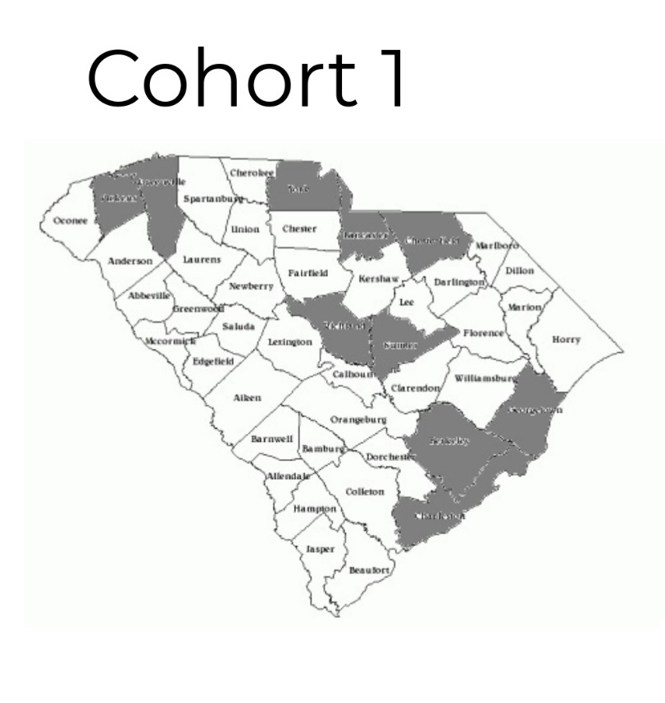
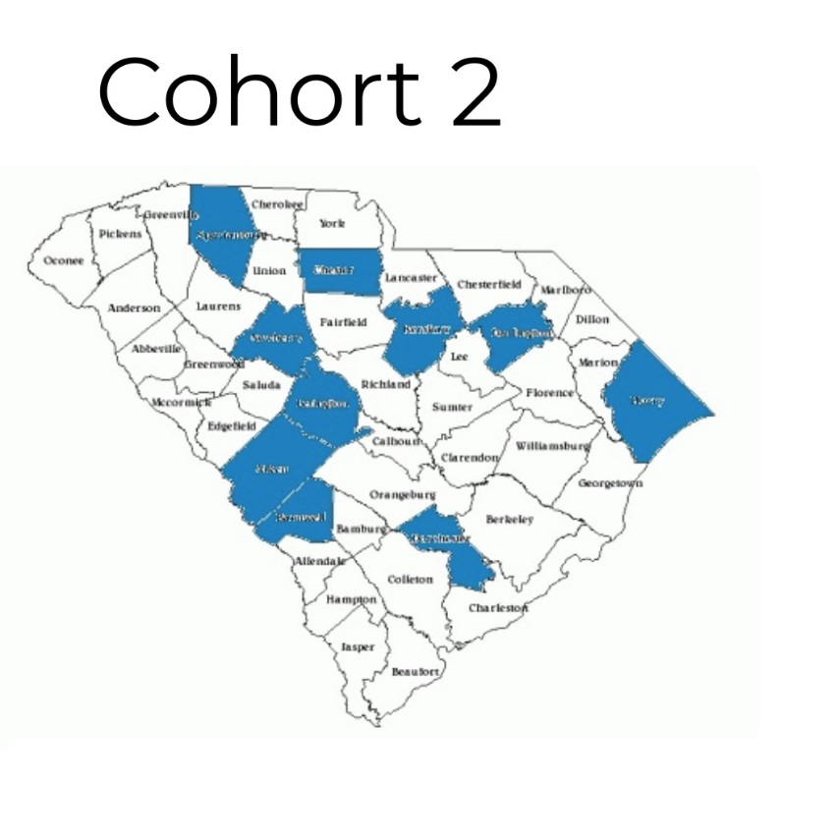
Counter Tools Program and County Involvement
South Carolina Department of Alcohol and Other Drug Abuse Services
Notes:
Cohort 1 – Timeframe Sept. 1, 2017 -

Slide 6
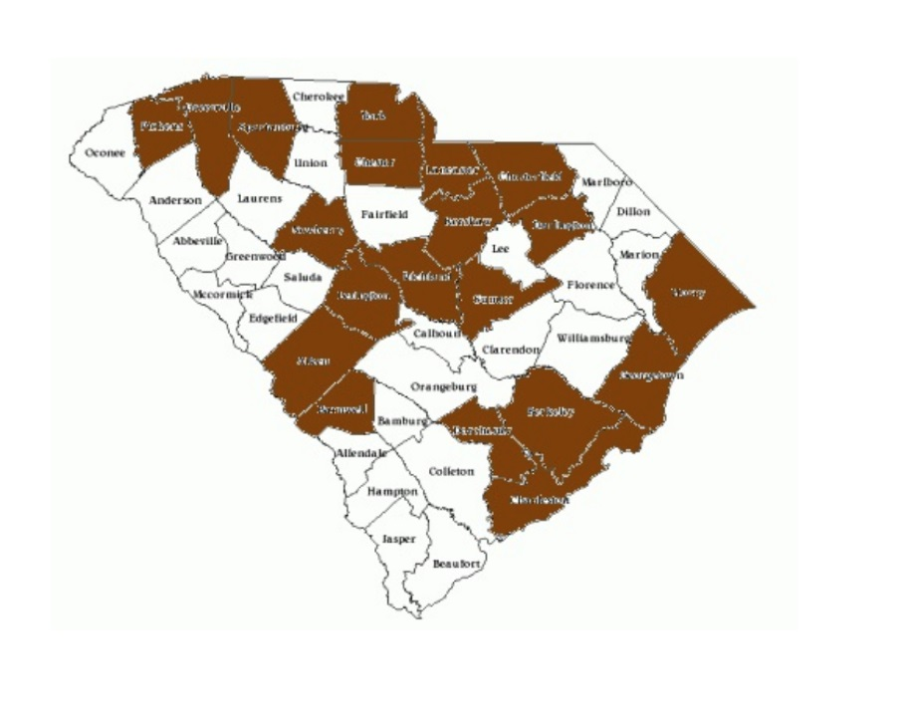
Progress We Have Made
South Carolina Department of Alcohol and Other Drug Abuse Services
10 counties (Cohort 1) have completed the data collection process and are moving forward with various POS efforts.
10 additional counties (Cohort 2) are in the data collection stage of the project.
DAODAS’s Goal:
Have all 46 counties participate

Slide 7
Examples of Counties’ POS Issue
South Carolina Department of Alcohol and Other Drug Abuse Services
County
Lancaster
Pickens
Greenville
Georgetown
York
POS Issue
Retailer proximity to schools
Retailer proximity to youth/schools
High density of retailers in low income areas
High density of alcohol/tobacco retailers near one another
Retailer proximity to K-12 schools & high density of alcohol/tobacco retailers near one another
(M. Mayfield, personal communication, January 16, 2018).

Slide 8
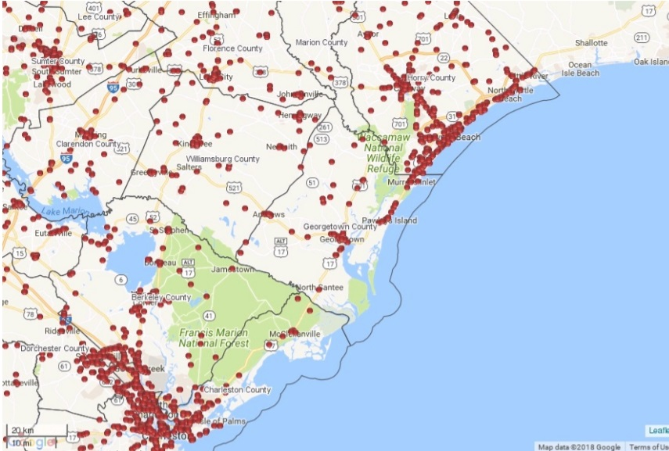
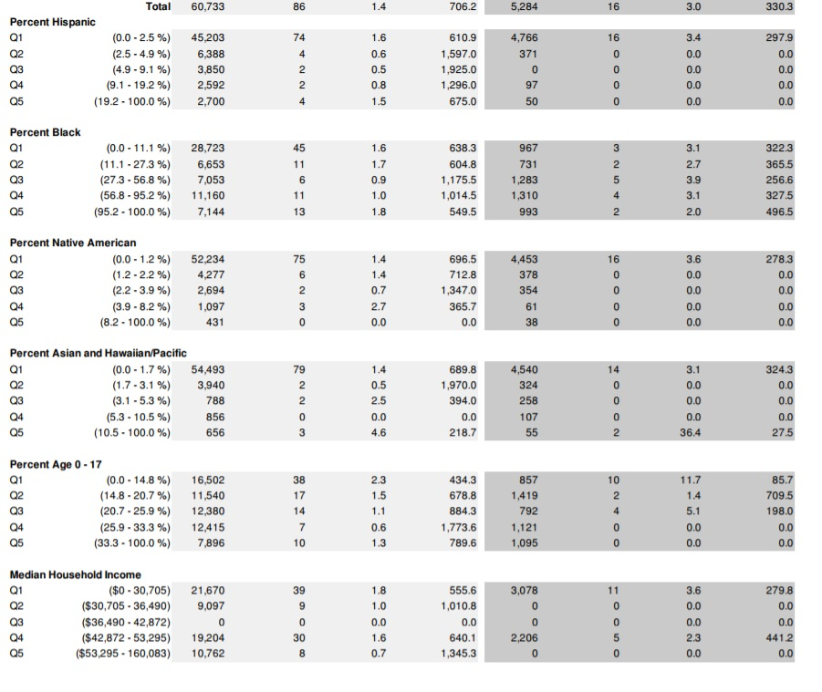
Georgetown’s POS Effort
South Carolina Department of Alcohol and Other Drug Abuse Services
“It [The POS data] gave us a lay of the land.” – Raphael Carr
(Counter Tools, Inc., “Get a report”, 2018)
(R. Carr, personal communication, January 18, 2018)
Notes:
Stage of Action: Capacity Development and planning the Community Awareness piece.

Slide 9
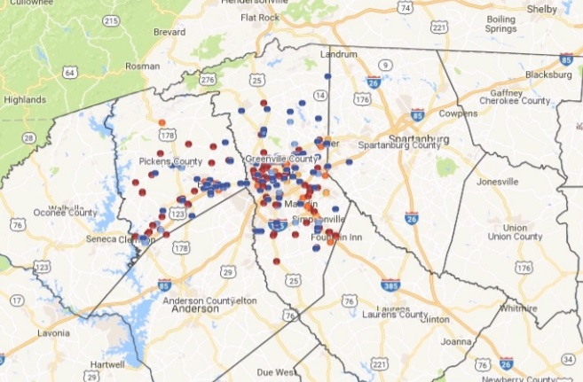
Greenville’s POS Effort
South Carolina Department of Alcohol and Other Drug Abuse Services
“[We need to] rely on partners to expand our approach to tobacco prevention… I need new stuff to have conversations with people I already know. When you present new data, you can keep their interest.” – Terry Taylor
(T. Taylor, personal communication, January 18, 2018)
(Counter Tools, Inc., “Store Mapper”, 2018)
Notes:
We must rely on partners to expand our approach to tobacco prevention. I need new stuff (information/data) to have conversations with people I already know. When you present new data – you can keep their interest.

Slide 10
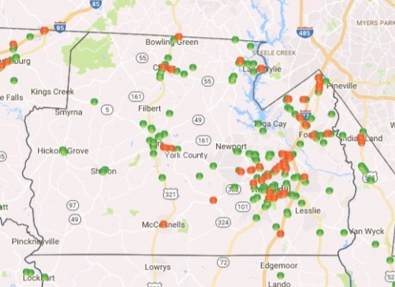
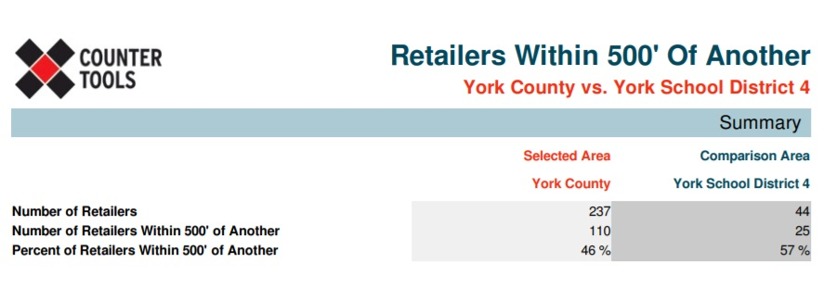
York’s POS Effort
South Carolina Department of Alcohol and Other Drug Abuse Services
“How do we get there from where we are? We need to work with decision makers and we realize that grandfathering existing retailers in under any new ordinances will be required. Thus, it may take a few years to see the real impact of new POS policy that we are going after.” – Dave Keely
(Counter Tools, Inc., “Get a report”, 2018)
(D. Keely, personal communication, January 18, 2018)

Slide 11
DAODAS’s Goal – To reduce tobacco use among youth in South Carolina
South Carolina Department of Alcohol and Other Drug Abuse Services
“Federal law requires states to implement tobacco policies that seek to reduce access to tobacco and tobacco products.” (Department of Alcohol and Other Drug Abuse Services, 2017)
Gathering POS data helps tobacco-free advocates inform and push for better and more comprehensive tobacco prevention and control policies.
Utilizing data from the Counter Tools Project also enhances DAODAS’s tobacco outcome plan for South Carolina.

Slide 12
DAODAS’s Vision – Applying the Strategic Prevention Framework (SPF)
South Carolina Department of Alcohol and Other Drug Abuse Services
After the POS plan/program is complete, practitioners can conduct the summative evaluation to determine the effect the POS plan/program had in terms of its outcome.
With the desired planning team in place, the local- and state-level practitioners can then plan the most appropriate culturally competent and sustainable POS intervention.
Conducting POS assessments gives local- and state- practitioners the ability to identify the tobacco prevention and control problems that are present in communities
Next, practitioners can put their POS plan and intervention into place. While the plan and intervention are ongoing, the implementers can actively conduct a formative evaluation of the POS plan/program.
Once the local- and state-level practitioners prioritize their POS issue, they need to determine which community coalitions, organizations, faith-based groups, youth leadership teams, key stakeholders, etc. need to be included in the desired intervention.
(Substance Abuse and Mental…, December 1, 2017)
Notes:
The steps of SPF include:
Step 1: Assess Needs – determine what is the problem, and how can I learn more?
Step 2: Build Capacity – What do I have to work with?
Step 3: Plan – What should I do and how should I do it?
Step 4: Implement – How can I put my plan into action?
Step 5: Evaluate – Is my plan/program succeeding?
The two guiding principles of the SPF include -> cultural competence and sustainability.

Slide 13
References
South Carolina Department of Alcohol and Other Drug Abuse Services
Counter Tools, Inc. (2017). Counter Tools: Training & Technical Assistance. Retrieved from https://www.countertools.org/training-technical-assistance
(M. Mayfield, personal communication, January 16, 2018).
(R. Carr, personal communication, January 18, 2018).
(T. Taylor, personal communication, January 18, 2018).
(D. Keely, personal communication, January 18, 2018).
Counter Tools, Inc. (2018). Get a report. Retrieved from https://mapping.countertools.org/southcarolina/
Department of Alcohol and Other Drug Abuse Services. (2017). Daodas block grant governing terms fy 2018. Columbia, SC.
Substance Abuse and Mental Health Services Administration. (December 1, 2017). Applying the strategic prevention framework (spf). Retrieved from https://www.samhsa.gov/capt/applying-strategic-prevention-framework

Slide 14
CONTACT US FOR MORE INFORMATION
South Carolina Department of Alcohol and Other Drug Abuse Services
Physical Address:
1801 Main Street, 4th Floor
Columbia, SC 29201
Phone:
803.896.5555
www.daodas.sc.gov

